Slide 1
Reactive programming
With Spring Webflux

Slide 2



Spring Webflux – Under the hood

Slide 3
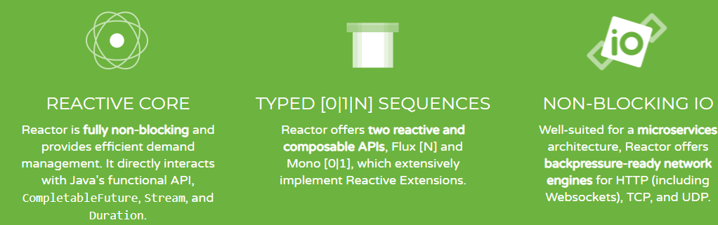
Project Reactor

Slide 4
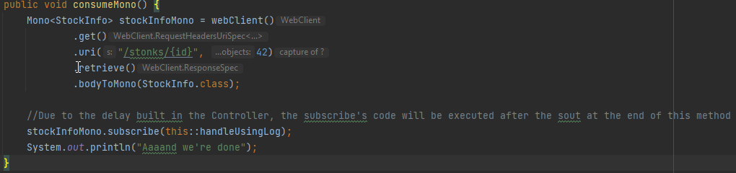

Non-blocking I/O

Slide 5
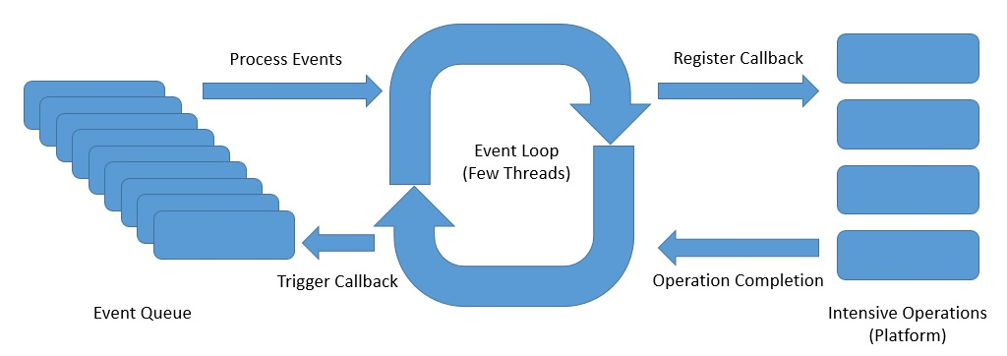
Behind the scenes

Slide 6
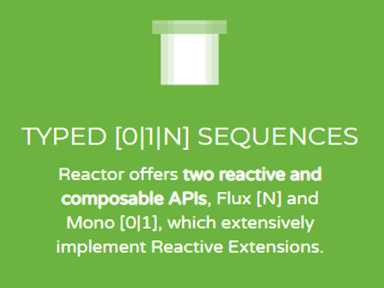
Mono and Flux

Slide 7
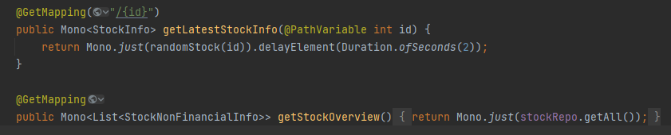
Creating a Mono

Slide 8
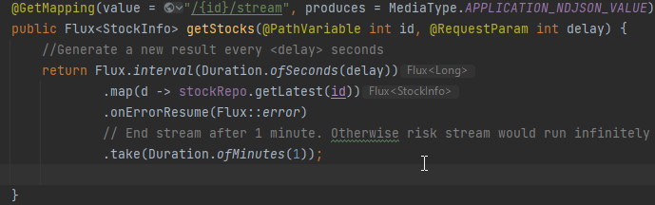
Creating a Flux

Slide 9
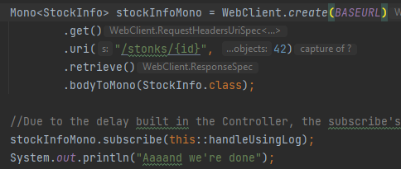
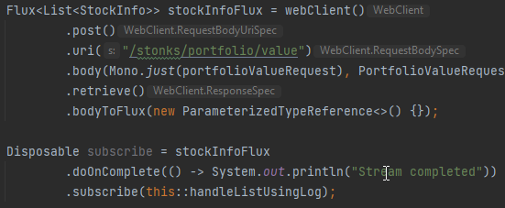
Consuming Mono’s and Flux’s – Enter the WebClient

Slide 10

Backpressure

Slide 11
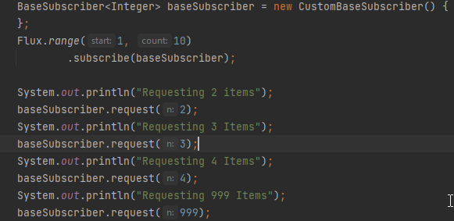
Consumer requests data in chunks

Slide 12
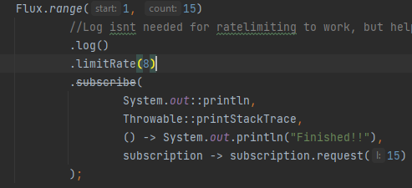
Producer offers data in chunks

Slide 13

Setting up
Step 1:

Slide 14
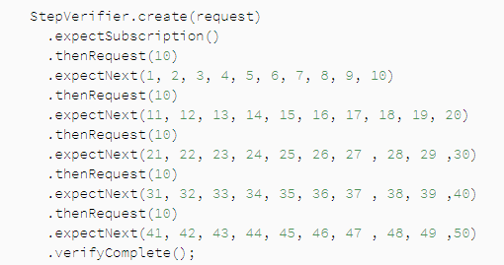
Testing reactor functions

Slide 15
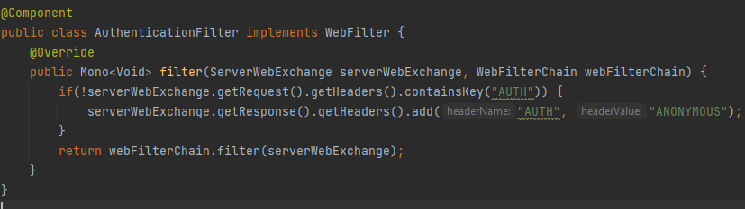
Filters

Slide 16
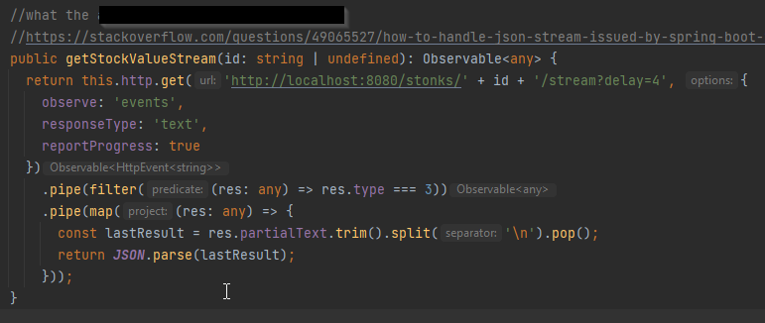
Problems: Angular & consuming JSON Streams

Slide 17




Problems: Documentation and Volatile API

Slide 18
Problems security
Different API, different problems

Slide 19
The end result

Slide 20
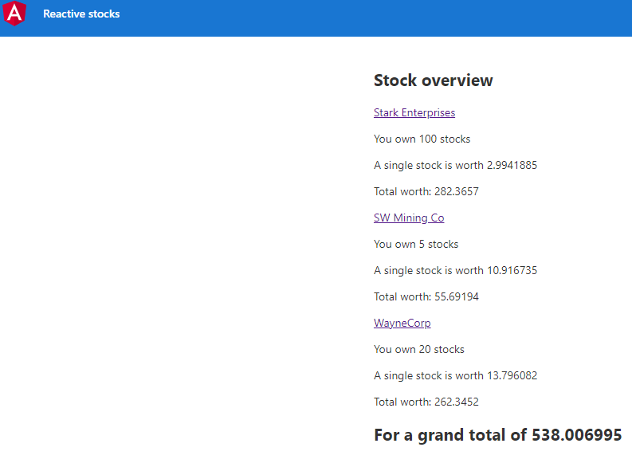

Slide 21
